Slide 1


Project of Customer activation and retention
E-retail factors for customer activation and retention: A case study from Indian e-commerce customers
By, Madhurima Srivastava/internship 30

Slide 2
Lets Understand what's the question is asking:- -> This case study is about online e-commerce shopping. -> As customer satisfaction is important, the team of the marketing team tries to analyse how they can attract the customer as well as how they can hold the customer. -> While analysing, its shows that service quality, system quality, information quality, trust and net benefit are the five most major factors are there to contribute in this -> More investigation shows that if the designs will be more practical and useful rather than attractive , customer is getting more attracted to that. -> A dataset taken from a online shopping app (given below the details) will give us the point of view, and the process to analyse the data for further more prediction.

Slide 3
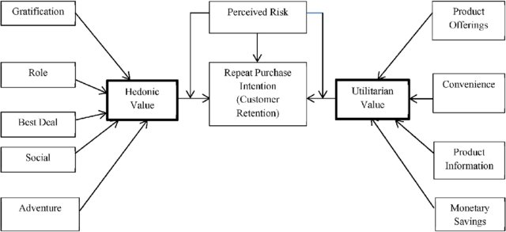
FACTORS AFFECTING THE PURCHASE INTENTION OF THE CUSTOMERS

Slide 4
Lets Check, what’s the data is saying:-
-We have a data of 269 users collected from a survey, in this data set users were asked about their suggestions about online shopping from different online sites like Amazon, Flipkart, Myntra, Paytm, Snapdeal, etc. -Our data includes all the factors which are part of both Hedonic and Utilitarian values.
-We have 71 variables and all of them are categorical in nature.
These variables are used to check the purchase decision of the customers. -Based on their experience how they rate online shopping for a particular site.

Slide 5
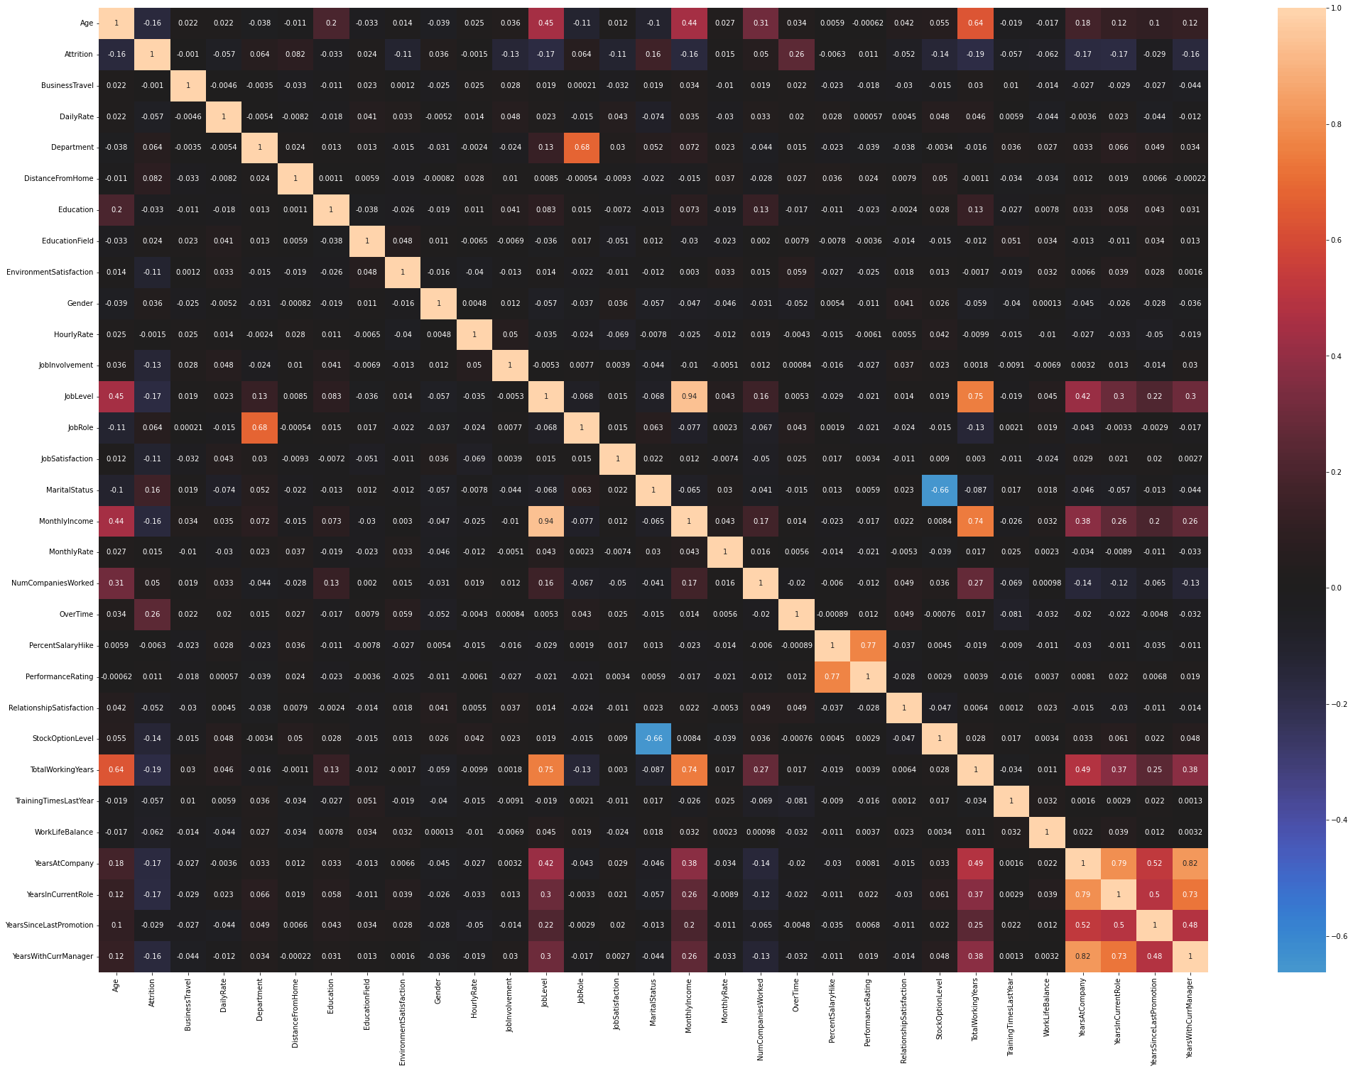

Slide 6
Observations:-
I have used spearman correlation technique to check the correlation between all the variables because most of the variables are Ordinal in nature.
We can see that there are many variables which are highly positive and negative correlated with each other.
We can remove one of the highly correlated variables and then feed the data for model building.

Slide 7
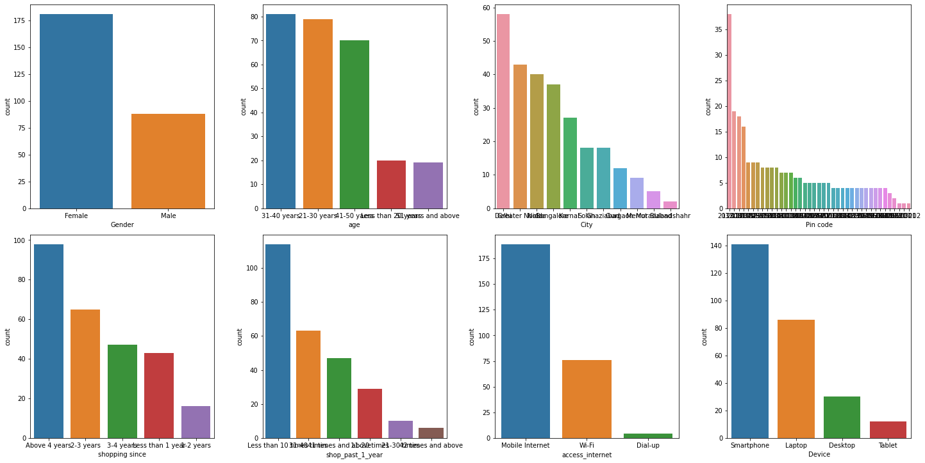
UNIVARIATE ANALYSIS
1. ***Gender of respondent*** - Here we can see that the number of female customers are more than of the males. Count of Female customers are more than 175 where male customers are ranging between 75-100.
2. ***Age of customer*** - we can see that the customer aged between 21 years to 50 years are more likely to shop online. 31-40 years shows the maximum number of shoppers followed by 21-30 and 41-50 years.
3. ***City*** - we can see that most of the online shopping is done in Delhi followed by Greater Noida and Noida, Moradabad and Bulandshahr shows minimum online shopping customers.
4. ***Pin code*** - we can see that 201308 which is the Pin code of Noida shows maximum online shopping customers, this is only if we compare with unique pin code otherwise Delhi has the most number of online customers.
5. ***Shopping duration*** - most of the customers are doing online shopping for more than 4 years.
6. ***Shopping in last 1 year*** - this shows that most of the customers shopped less than 10 times, the reason could be that they don't use online shopping for their basic needs like food, groceries. They use online shopping for the products which has high durability.
7. ***Internet access*** - customers usually use mobile internet the most for online shopping, the reason could be that using mobile app and mobile internet they can shop any where any time without having a wifi nearby.
8. ***Device for online shopping*** - Smartphone is most preferrable by the customers as it provides ease in navigation and more attractive , easy to use. However we can see that laptop and desktop are classified uniquely here, if we merge these two then count of the customer using these 2 devices will be closer to the count of the customers using smartphones.

Slide 8
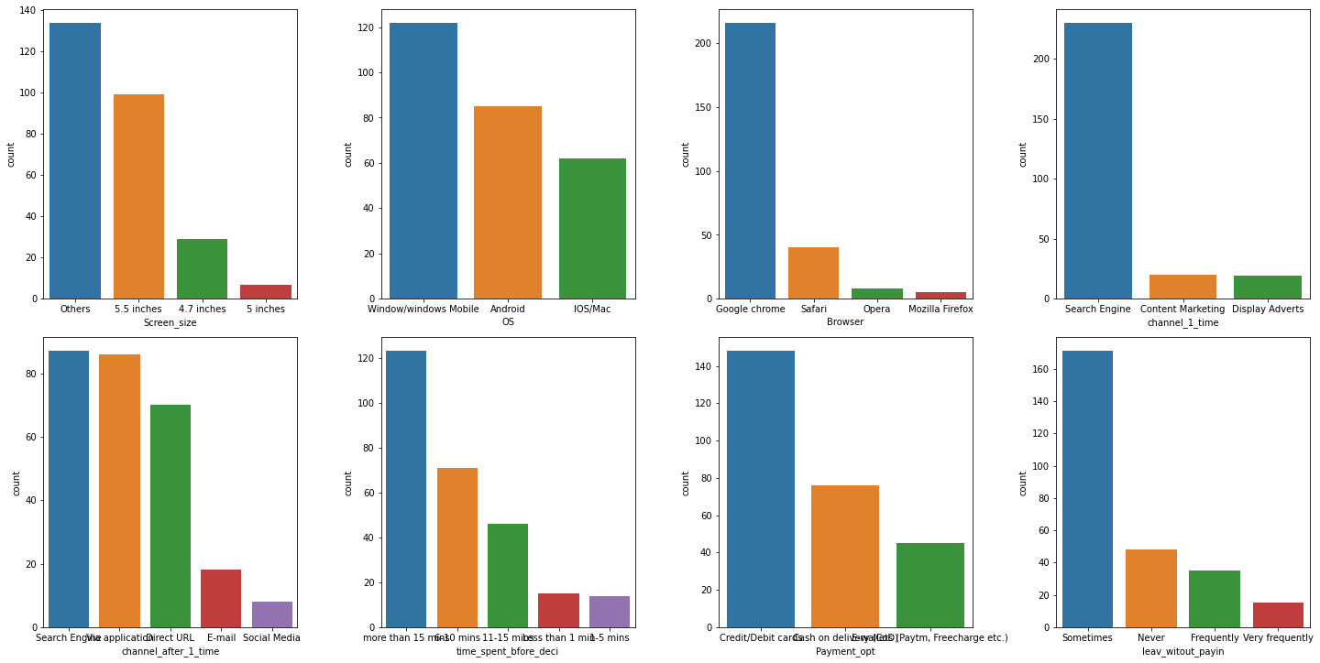
9. ***Screen size*** - 'Others' here denotes the size of laptop or computer as usually their screen size is more than 10 inches. Others shows the maximum count here followed by 5.5 inches.
10. ***OS type*** - windows shows the maximum count as this can include both smartphones and desktop/laptop. In India user base of android is more than of apple IOS that is why here we can see that android based customers are more than of the IOS.
11. ***Browser*** - Google chrome is the most widely used web browser across world, An estimated 2.65 billion internet users globally use Chrome as their primary browser. That is why our data also shows that the customers are more likely to use Google chrome while they search for things online and shop online
12. ***Channel*** - customer do online shopping using search engine as it will give them many options available.
13. ***Channel after 1 visit*** - most customers still goes for using search engine followed by app users.
14. ***explore time*** - most customers usually explore more than 15 mins, the time taken due to comparison of the product, reading product details, alternatives for the product chosen.
15. ***Preferred payment option*** - Credit cards and Debit cards are most widely use of payment method , the reason is simple that on these payment mode customer gets many offer , some banks also partner with the online shopping site for the benefits of the customers.
16. ***abandon while shopping*** - most of the customer abandon the shopping cart, the reason could be that they find a better alternative, promo code isn't working, delivery of product takes too long etc

Slide 9
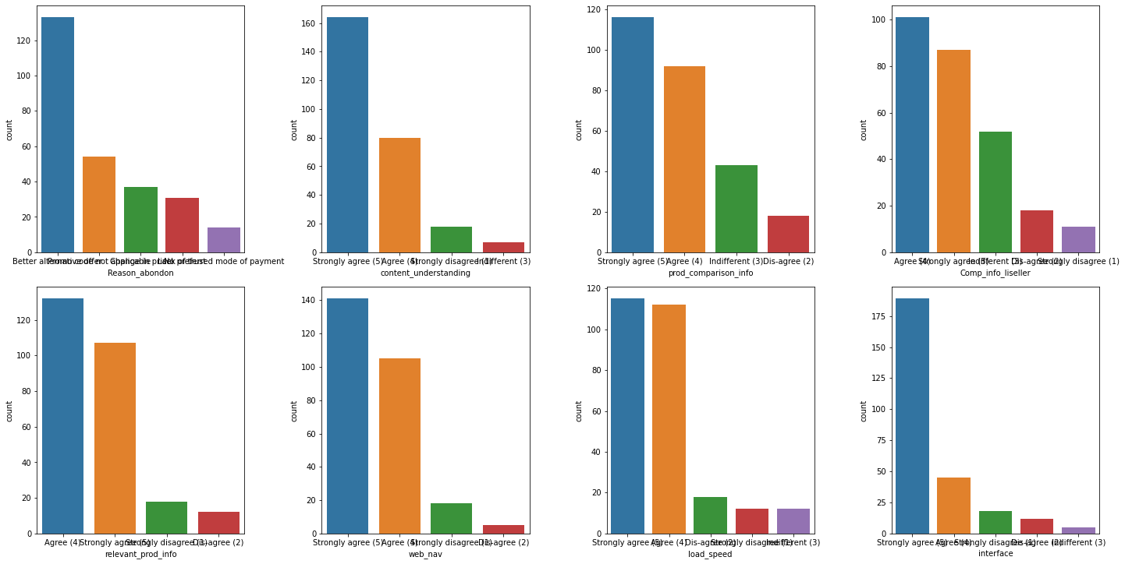
17. ***Abandoned cart reason*** - The most common reason for abandoning the cart is having a better alternative offer, and promo code not applicabe.
18. ***website content is easy?*** - Most customers agrees that the content on website is much easier to understand.
19. ***similar product information*** - most of the customers find the information of similar products useful for comparison.
20. ***complete product information*** - this affect the purchase decision of the customer, Most of the customer find this important while the do online shopping.
21. ***product information*** - most of the customers feels that listed product should have complete details of it. This will affect the purchase decision of the customer.
22. ***Navigation on website*** - Every customer wants to have easy navigation steps while doing online shopping.
23. ***Loading and processing speed*** - most of the customers feels that loading and processing speed also affect their purchase decision.
24. ***Interface of website*** - Most customers like having a good interface of the website, that attracts customers and affect their purchase decision.

Slide 10
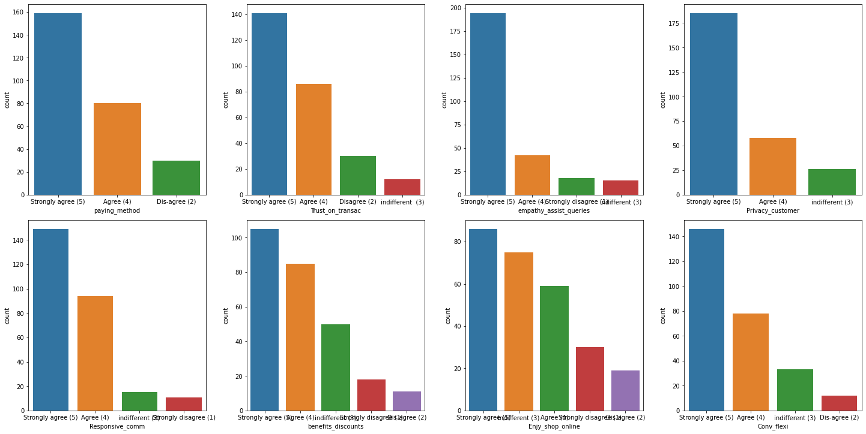
25. ***Payment convenience*** - most of the Customer (almost every) wants a convenient payment method.
26. ***Trust on online retail store*** - Most of the customers believes that the respective online retail store will full fill the transaction within given time by the merchant.
27. ***Empathy*** - bases on query solving on a particular site like amazon, flipkart it is very important to resolve the customer's query as this will affect the customer purchase decision in future
28. ***Data Privacy*** - This is becoming very important concern nowadays, as customer's details are very sensitive and customer will only provide data to those which have high data security., So most customers agree on this that there should be data security.
29. ***Communication channel*** - There are various communication channels available like email support, chat support, phone support etc, customer wants communication medium of their choice. They agree that the online store should have various communication channels available.
30. ***Benefits and discounts*** - Most of the customers agree that online shopping gives monetary discount and benefits, like cashback, reward points etc.
31. ***enjoyment*** - most of the customers like shopping online, it is hassle free and time consuming, however there are some customer's who don't like online shopping as much. However most of the customers agree that they enjoy doing shopping online.
32. ***flexibility and convenience*** - Online shopping is flexible and convenience, most of the customers agree on that.

Slide 11
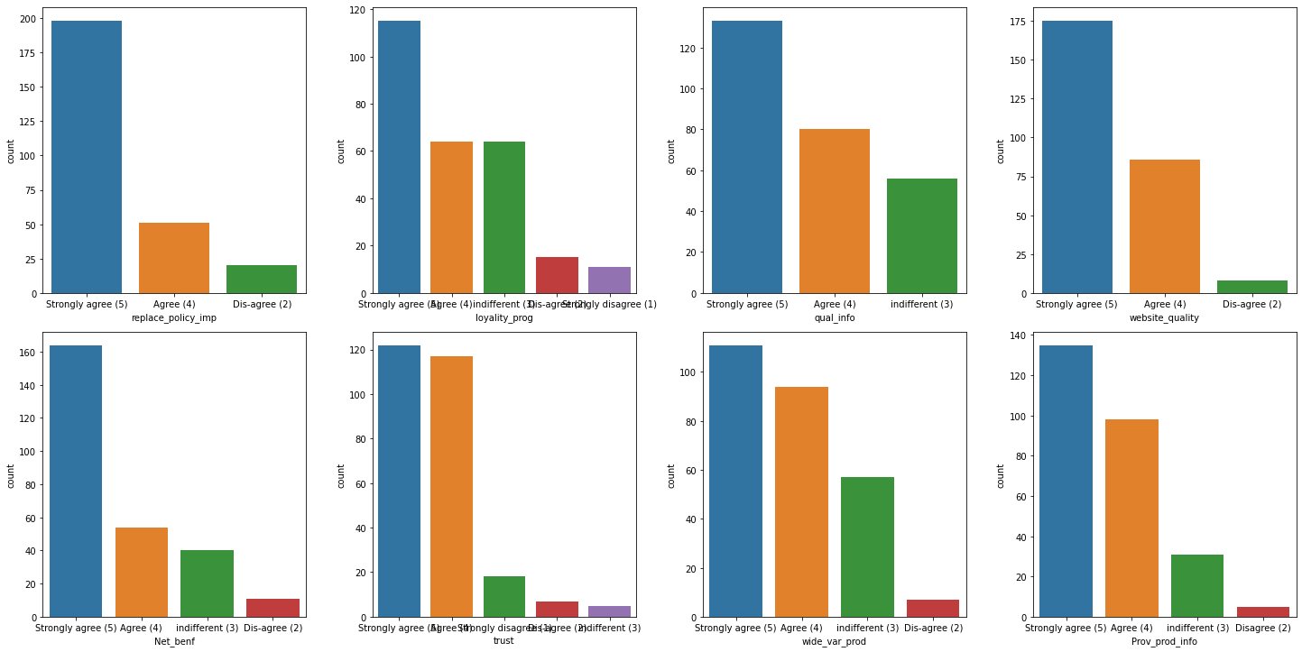
33. ***Return/replacment policy*** - most of the costumers agree on having return and replacement policy.
34. ***Loyalty programs*** - this refers to offers, rewards offered to customer so that the online retail store retain the customers. Example for this can be Flipkart's super coin, where for every purchase you will earn some amount of super coin that can be redeemed in future. Such policy attract customers and most of the customer's agree that some rewards option attract them.
35. ***quality information*** - Most of the customers find this important.
36. ***website/application quality*** - most of the customer's agree that a website or application quality should be good to retain the customers.
37. ***Net benefits*** - Most of the customer's agree on net benefits can lead to customer's satisfaction.
38. ***trust vs satisfaction*** - most of the customers agree on that trust results in customer's satisfaction.
39. ***variety of products*** - most of the customers agree on that online shopping shows wide variety of the products available.
40. ***relevant product info*** - most of the customers agree on this.

Slide 12
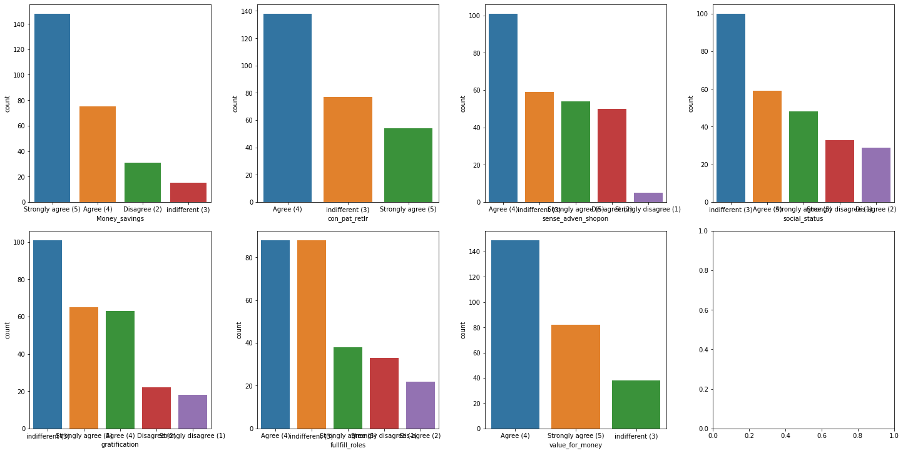
41. ***Monetary savings*** - most of the customers agree on that online shopping gives them monetary savings.
42. ***patronizing the online retailer*** - this means to provide support aid or offer to regular customers. Most of the customers agree on this.
43. ***experience*** - most of the customer strongly agree that they get a good experience when shopping online, however there are customers who are not sure and don't feel the same way.
44. ***Social status*** - most customers are indifferent in shopping online enhances their social status however there are also customers who disagree and agree on this.
45. ***Gratification*** - Customer satisfaction is defined as a measurement that determines how happy customers are with a company's products, services, and capabilities. Most of the customers are indifferent.
46. ***Website fulfilment*** - most of the customers agree and indifferent if the website fulfil their shopping exp.
47. ***Value for money*** - most of the customer agree on that they get great value for money by shopping online.

Slide 13
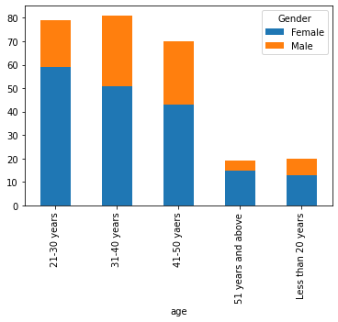
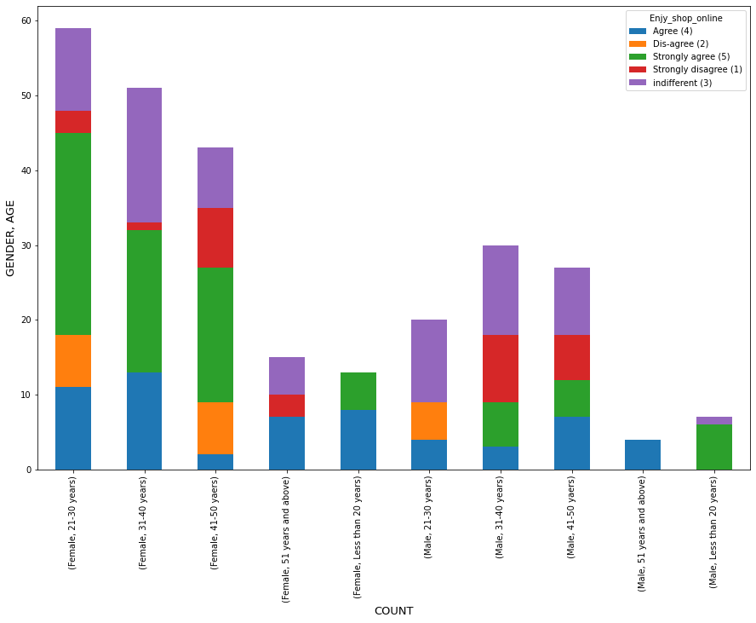
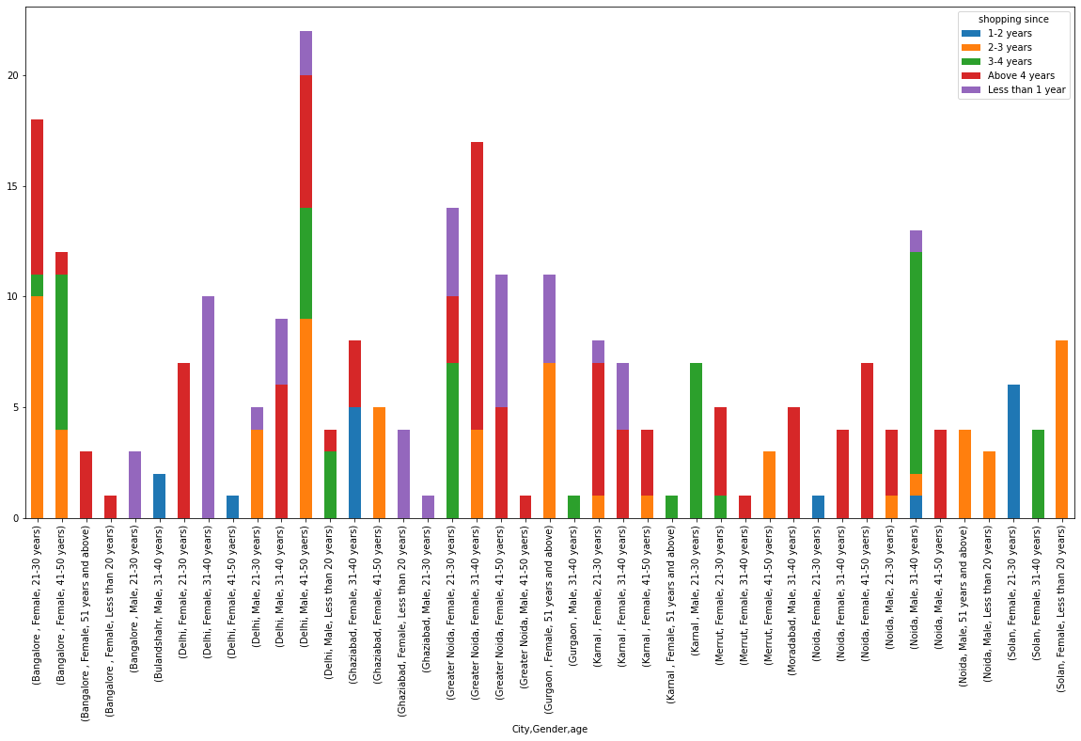

Slide 14
OBSERVATIONS
Here we can see that number of female customers in all age categories are more than of male, from age 21-30 years count of female customers is the most.
Data has more female customers.
Bulandshahar consists of only Male customers age between 31-40 years have been shopping online for 1-2 years.
Moradabad consists of only Male customers age between 31-40 years have been shopping for more than 4 years.
Gender ration is approx. equal in Delhi.
Bangalore shows maximum female customers age between 21-30 years.
Delhi shows maximum Male customers age between 41-50.
Female with age 21-30 are strongly agreeing that enjoying shopping.

Slide 15
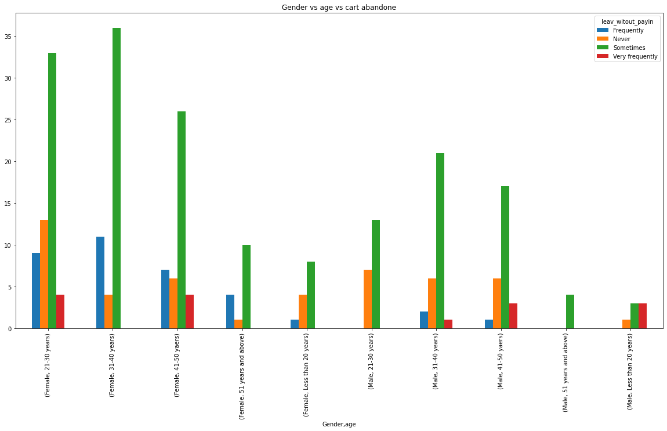
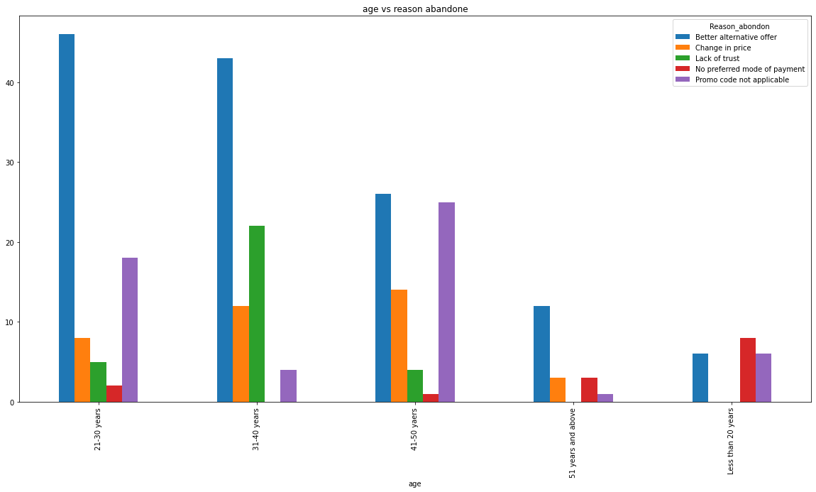

Slide 16
OBSERVATIONS
Females are more likely to abandon the online shopping cart.
Customers below 20 years old don't abandon that much.
Most the of the customers age between 21-50 years abandon the online shopping cart due to better alternative offers available to them. These are the customer tends to explore more while shopping online.
CHECKING IF AGE AND REASON TO ABANDON ARE DEPENDENT OR NOT
-To check the dependencies of independent categorical variable I have used chi square test. And based upon my test score I found out that these 2 variables are highly dependent.
-My null hypothesis was that the variables are independent.
-Using chi square test I have calculated the critical value and
Chi statistic value and compared the scores
-To check if null hypothesis is acceptable or not.
Here we can see that the age of the customer and the
-Reason for abandoning the online shopping cart
is very highly dependent with each other.

Slide 17
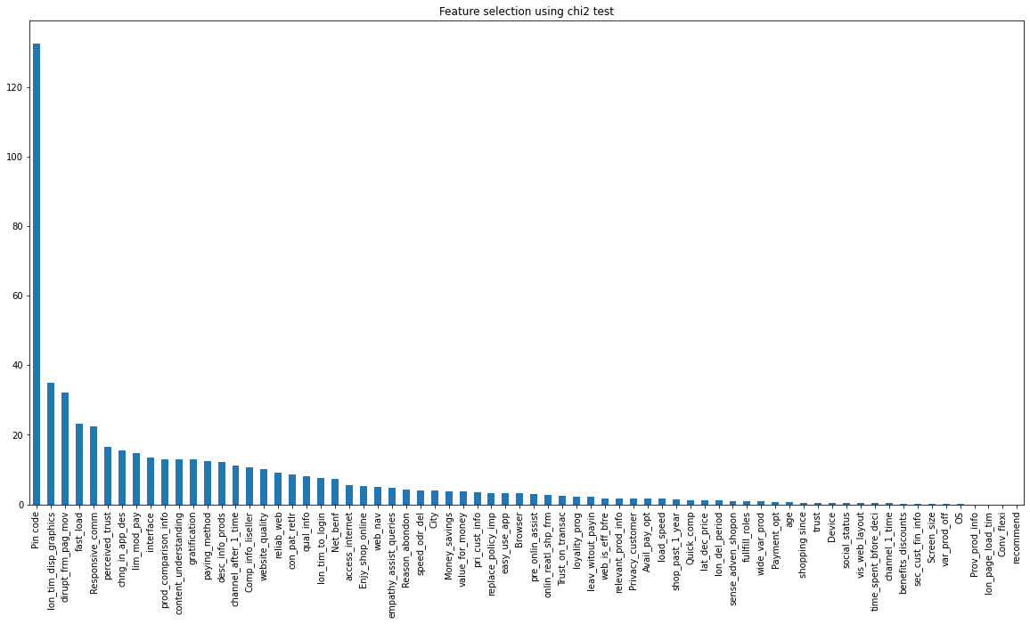
FEATURE IMPORTANCE USING CHI-SQUARE

Slide 18
I have used chi square test to check the importance of each independent variable towards the target variable Gender.
As we have categorical variable data so the chi- square test is the best to check the variable importance.
I have calculated the variable importance depending upon the F-score of each variable.
Higher the F-score means higher the importance of variable.
I have used Chi2 module/library from sklearn.feature_selection and then plotted the bar graph in descending order to show the variable importance visually.
OBSERVATIONS
Based on chi-square test I can observe that hedonic type of variables are showing more importance to the target variable Gender.
We will not consider Pin code here as it will not make sense here to classify the gender of the user, however based on pin code it can be checked the distribution of users (male and female) at a particular location.
Interface, trust, responsive communication etc, all these types refers to the hedonic values. These variables showing more importance.

Slide 19
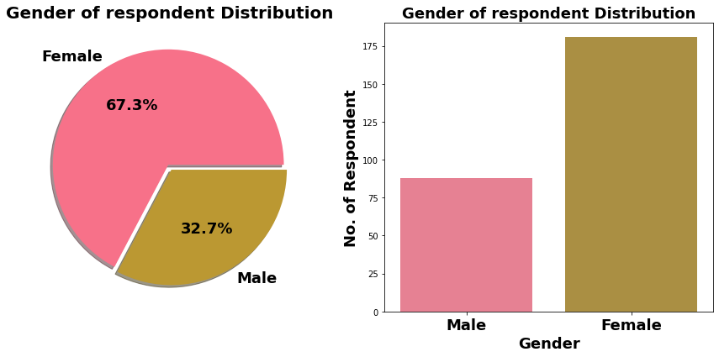
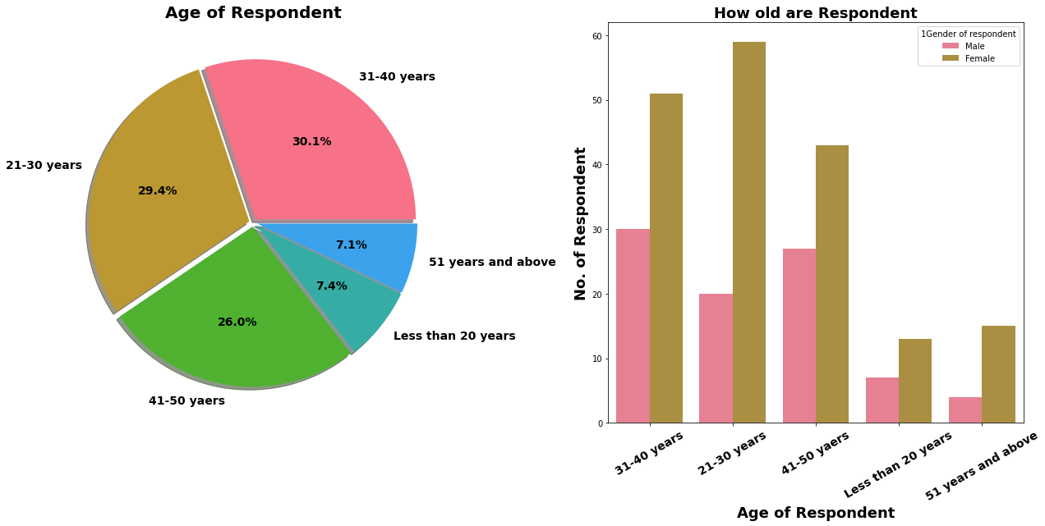
Observation :
Majority of female customers are between age group of 21-40 years.
Within Male Customers Tendency of online shopping seen among age group of 31-50 years.
For both gender tendency of shopping is less for age greater than 51 years old.
This may be due to decrease in materialistic tendency with age or possible Less TECH-SAVY Generation.

Slide 20
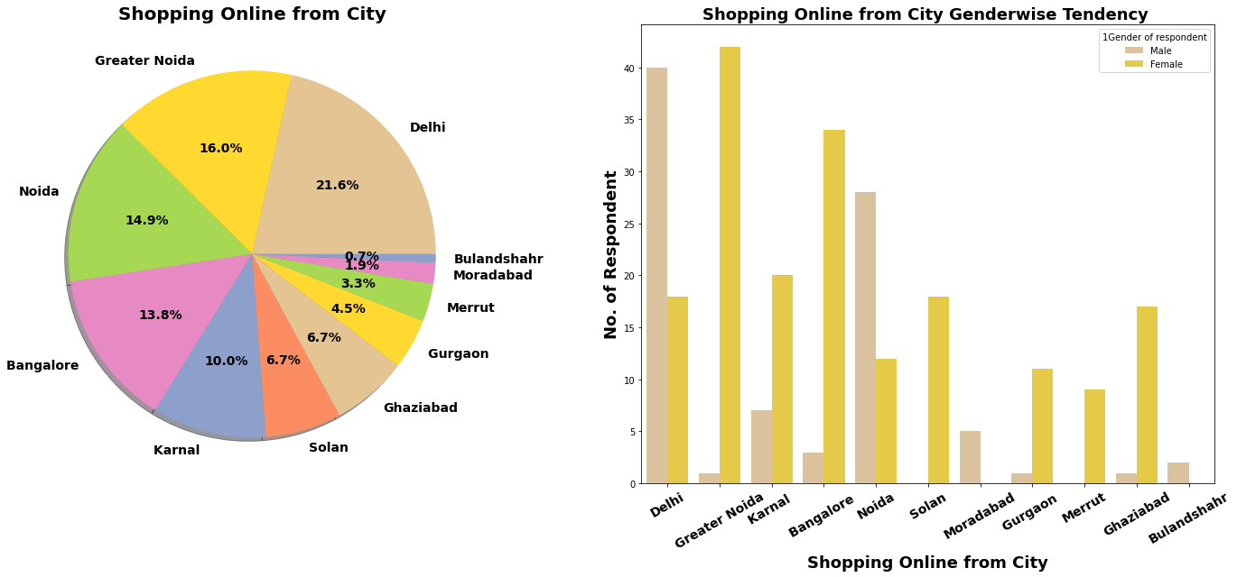
Observation :
Most Online Shopping Customer belong to Metro Cities. and most of them are Male customer
We can conclude that in Metro city like Delhi, Male have more tendency of online shopping.So shopping platfrom can target this population in marketing.
In Tier 2 & 3 Cities Majority of online shopping customers are Females.
We can target these customer population in these cities.

Slide 21
Observation :
We already Know more than 90% Customer thinks that gaurantee on privacy of thier information is important for them.Majority of customers trust Amazon.in more than other shopping platform for Privacy of customers’ information Majority of customer trust Amazon.in followed by Flipkart.in over Security of thier financial information.We also see very few peoples trust payment platform paytm.
Amazon.in, Flipkart.com, Myntra.com, Snapdeal.com provide assistance through different multi channel.
Longer time to get logged in can annoyed customer. Amazon.in take longer time to logged in while Flipkart.com take least time among all.
Majority of people agree that Amazon.in, Flipkart.com takes longer time in displaying and photos.
Myntra.com followed by Paytm.com take longer page loading time.
Most of people want shorter delivery time frame, majority customer agree that Paytm.com takes longest time for delivery compare to others.
Amazon.in website is as effient as ealier after updation.
Majority 80 peoples recommanded Amazon.in to their friends.

Slide 22
Thank You

